Slide 1
Excel Basics
Excel Day 1 class

Slide 2
Learning Objectives
By the end of this lesson, you will be able to:
Identify and describe key components of the Excel interface, including workbooks, worksheets, ribbons, and cell references
Enter different types of data into Excel worksheets, including text, numbers, formulas, and functions
Edit cell contents and perform copying/pasting within Excel worksheets
Apply basic formatting to cells and cell content like fonts, colors, borders, and alignment
Construct basic Excel formulas using common operators and cell references

Slide 3
Learning Objectives
Being skilled with excel enables analysts to:
turn raw data into meaningful insights to make smarter decisions
Collaborate & communicate more effectively at work
Organize, analyze and report on data more efficiently
Excel is a versatile skill that makes you better with numbers, organization, analysis and visualization - helping you be more efficient, insightful and communicate better

Slide 4
Introduction to the Excel Interface
Workbooks
Files that store your Excel data
Workbook files have .xlsx extension (newer) or .xls (older)
One workbook can contain multiple sheets or tabbed sections
Contain one or more worksheets
Worksheets store a table of data, calculations, visualizations
Each sheet labeled with tabs along bottom
Can add/delete/rename sheets as needed
Workbook tabs shown at the bottom
Allow switching between different sheets
Display sheet names
Color coded for easier identification
Right click tab to add, delete, rename sheets

Slide 5
Introduction to the Excel Interface
Creating new workbooks & worksheets
Blank workbook opens by default when launching Excel
Go to File > New to create new blank workbook
Add sheets via Insert > Insert Sheet command
Customize name, placement when adding sheet
Opening, saving closing workbooks
Recent files listed on Start screen
Go to File tab to Open existing files
Save frequently via Save button or Ctrl+S
Save As to save a copy with new name
Close button or Alt+F4 to close workbook

Slide 6
Introduction to the Excel Interface
Worksheets
Pages within a workbook to organize data
Store and organize table data on separate pages
Add separate sheets for different datasets
Color code sheets or name them descriptively
Grids of rows and columns
Columns labeled A to Z then AA, AB etc
Rows numbered 1 to over 1 million
Cells form at intersection of rows & columns
Grid layout enables table formats
Tabbed interface to switch between sheets
Tabs shown at bottom allow switching
Control+PageUp/Page Down also switches
Right click tab for add/delete/rename

Slide 7
Introduction to the Excel Interface
Inserting sheets
Insert > Insert Sheet command
Set name, placement of new sheet
Deleting sheets
Right click sheet tab > Delete
Caution - deletes sheet contents
Renaming sheets
Double click sheet tab name
Edit to descriptive name
Helps identify sheet content at a glance

Slide 8
Introduction to the Excel Interface
Cells
Intersections of rows and columns
Rectangular boxes formed by gridlines
Horizontal rows and vertical columns intersect
Each cell has a unique cell reference
Identified by cell references
Column letter + row number (A1, B2, etc)
Top left cell is A1
References used to locate cells for input or analysis
Contain data - text, numbers, formulas
Cells hold content such as text, numbers, dates
Can input data directly or reference other cells
Formulas perform calculations using cell data
Visualizations can also be placed inside cells

Slide 9
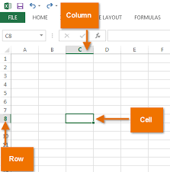
Introduction to the Excel Interface
Cell content remains inside cells
Content moves when cells shifted but retained within
Adjust row heights/column widths to fit content
Merge cells to combine into larger cell space
Wrap text to display over multiple lines

Slide 10
Introduction to the Excel Interface
Step-by-step exercise for testing out basic Excel cell functionalities:
Open a new Excel workbook
In cell A1, type your name (e.g. John)
In cell B1, type a number (e.g. 27)
Change the font color of your name to something other than black. Highlight cell A1 and click the red, blue or green font color on the Home tab.
Resize the height of A1 and B1 to fit content better. Hover over the bottom border of cell A1 or B1 and drag it taller.
Merge A1 and B1 into one cell by highlighting A1:B1 and clicking Merge Cells on the Alignment tab. "John 27" should display in one bigger cell

Slide 11
Introduction to the Excel Interface
Cell references
Naming convention uses column letter & row number
Column letter comes first to identify vertical position
Followed by row number to specify horizontal position
Ex. Cell A1, B2, AA345, etc.
Column labels A to Z then AA to AZ etc
Columns labeled A to Z left to right
After column Z comes AA, then AB and so on
Can extend to XFD (16,384 columns)
Rows numbered 1 to over 1 million
Rows start at 1 at the top
numbered down to 1,048,576 rows
Enough rows for even largest data sets

Slide 12
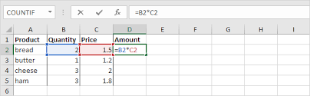
Introduction to the Excel Interface
Allows formulas to connect data across cells
References enable linking cells in calculations
Don't need to repeat raw data in formulas
Can build functions using references
Ex. =SUM(A1:A5) totals those cells
Relative vs absolute references

Slide 13
Introduction to the Excel Interface
Ribbons vs Classic Menus
Ribbon
Tabbed toolbar interface
Tabs organize commands into groups
File, Home, Insert, Page Layout etc
Ribbon collapsible to regain space
Related features grouped
Tools for styling text on Home tab
Tables commands on Insert tab
Adaptive to show contextual tools
Changes based on content selected
Shows table tools when table clicked

Slide 14
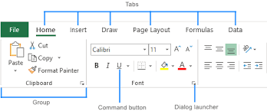
Introduction to the Excel Interface
Ribbons vs Classic Menus
Ribbon

Slide 15
Introduction to the Excel Interface
Classic Menus
Dropdown menus across top
File, Edit, View etc classic top menu
Contains all features in dropdowns
Access less used tools easily
More compact view
Takes up less static space
Fits more worksheet content when open
Can be distracting switching between
Less frequently used now
Ribbons more common in current versions
Menu option still available
Familiar for long-time users

Slide 16
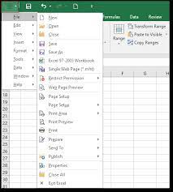
Introduction to the Excel Interface
Classic Menus

Slide 17
Entering and Editing Data
Types of Data in Excel
Text - letters, words, sentences
Numbers - numeric values like counts or measurements
Formulas - equations that perform calculations
Functions - predefined formulas like SUM(),AVERAGE()
Dates/Times - calendar dates or time values
Hyperlinks - links to web pages
Images - jpegs, gifs and other graphic files

Slide 18
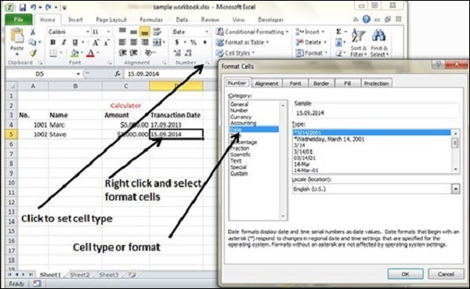
Entering and Editing Data
Types of Data in Excel

Slide 19
Entering and Editing Data
Entering Data
Typing directly into cells
Click on cell and start typing content
Enter text, numbers, formulas
Values displayed inside cells
Finish by pressing enter or clicking new cell
Copying and pasting data
Copy data from one cell/range
Paste into another cell/range
Retains formatting by default
Use Paste Special to only paste certain attributes

Slide 20
Entering and Editing Data
Drag and drop cells to move content
Click and drag a cell to new location
Cut the cell vs copy if desired
Easy way to reorganize data points
Importing from external sources (more on this later)
Import from data sources like CSV
Refreshable link to outside databases
Pull updated information easily

Slide 21
Entering and Editing Data
Editing Cells
Directly editing content in formula bar
View and edit the cell content in formula bar
Change text, numbers, formulas
See formula inputs
Press enter to commit changes
Double click to edit cell
Enables editing cell contents
Quick access cell editing
Use judiciously to prevent accidental edits
Copy, cut and paste
Classic copying and pasting
Ctrl+C, Ctrl+X, Ctrl+V shortcuts
Paste options for format vs values

Slide 22
Entering and Editing Data
Undo and redo
Undo icon reverses recent actions
Fix mistakes on the fly
Redo icon can reverse undo actions
Find and replace
Find specific text or values
Replace across selection or entire sheet
Useful updating many cells
Drag and drop cells
Click cell edge and drag to new location
Cut vs copy on drag
Rearrange cells quickly

Slide 23
Excel Keyboard Shortcuts
Navigation Shortcuts
Arrow keys - Move one cell up, down, left right
Ctrl + Arrow - Jump to edge of current data region
Page Up/Down - Move one screen up or down
Home/End - Move to beginning/end of row
Ctrl + Home/End - Move to beginning/end of worksheet
Selection Shortcuts
Shift + Arrow keys - Select cells from current to desired cell
Ctrl + Spacebar - Select entire column
Shift + Spacebar - Select entire row
Ctrl + A - Select all cells in worksheet
F8 - Select next object

Slide 24
Excel Keyboard Shortcuts
Most Commonly Used Shortcuts
Ctrl + C/Ctrl + V - Copy/Paste selection
Ctrl + Z - Undo recent action
Ctrl + F - Open Find dialog
Ctrl + P - Print worksheet
Ctrl + S - Save workbook
Ctrl + B/I/U - Bold/Italics/Underline
Ctrl + 1/2/3 - Format as Number/Currency/Date
Alt + = - AutoSum formula

Slide 25
Basic Formulas and Functions
Basic Formulas and Functions
SUM, AVERAGE, COUNT
SUM - Totals range of cells =SUM(A1:A10) sums 10 cells
AVERAGE - Mean average of cells =AVERAGE(B1:B10) averages 10 cells
COUNT - Counts numeric cells =COUNT(C1:C10) counts 10 cells
Reference Operators
Link cell data with:
Range: A1:A10
Union: A1,B2,C3
Intersection: A1:B2 C1:D2

Slide 26
Basic Formulas and Functions
Relative and Absolute References
Relative - Adjusts when copied (A1 = B1)
Absolute - Locked with $ symbol ($A$1)
Functions
Predefined formulas =IF(LogicalTest,ValueIfTrue,ValueIfFalse)
Nested functions: =IF(AND(A1>1,B1<100),SUM(A1:B1),0)
Let's look at more examples:
=(A1*3+B1)/C1 demonstrates order of operations
=SUM(Sheet2!A1:A10) references another sheet

Slide 27
Basic Formulas and Functions
Prepare Sample Data
Open a new worksheet
In cell A1 type "Sales"
In cell A2 type 100, in B2 type 200, in C2 type 150
In A3 type "Costs"
In A4 type 50, in B4 type 150, in C4 type 75
Basic Formulas
Click cell D2 and use the SUM formula: =SUM(A2:C2)
This sums all the sales figures
Click cell D4 and use AVERAGE: =AVERAGE(A4:C4)
To average all cost cells

Slide 28
Basic Formulas and Functions
Relative and Absolute References
Copy the sum formula from D2 to D4
Notice cell references change relative to new location
Click in cell E2 and type a sum formula using absolute references: =SUM($A$2:$C$2)
Copy this down to E4
References remain fixed to original cells
Add More Data
Extend sales data down to row 10
Update sum formula to include all new cells: =SUM(A2:C10)

Slide 29
Order of Operations in Formulas
The order of operations determines the sequence in which calculations are performed in formula with multiple operators. Excel follows the same PEMDAS order as general mathematics:
P - Parentheses and Nested Functions
Calculations inside parentheses and nested functions are performed first
Innermost parentheses solved initially
Ex: =((A1+A2)+(B1-B2)) resolves inner brackets first
E - Exponents
Any exponential calculations are done next
Ex: =A1^2+B1 calculates the exponent before addition

Slide 30
Order of Operations in Formulas
MD - Multiplication and Division
Any multiplication and division is then performed
Solved left to right as they appear in formula
Ex: =A1*B1/C1 does multiplication then division
AS - Addition and Subtraction
Finally addition and subtraction completes formula
Also solves left to right based on appearance
Ex: A1+B1-C1 adds then subtracts terms
Some examples:
=B1*B2+B3^2 - * first, ^ second, + last
=(A1+A2)A3 - () first, * second
=B1/B2B3-B4+B5 - / first, * second, - third, + last

Slide 31
Relative and Absolute Cell References
Relative Cell References
Adjust cells referenced when copied to new location
Denoted by just the cell reference, ex A1
When copied across rows or columns, the relative position changes
Useful for repeating similar calculations
Absolute Cell References
Locks reference to an exact cell address
Denoted with $ signs before row and/or column, ex $A$1
When copied, the cell address does not adjust
Useful when need to always point to the same cell range

Slide 32
Relative and Absolute Cell References
Usage Examples:
Relative: =A1+B1 When copied across columns changes to =B1+C1
Absolute: =$A$1+$B$1 When copied across columns stays as =$A$1+$B$1
Mixed: =$A1+B$1 Row adjusts but column stays fixed when copied
Best Practice Tips:
Use absolute references to source data that should not change.
Use relative references for repeating formulas where adjacency is important.

Slide 33
Relative and Absolute Cell References
Exercise
Open a new Excel worksheet
In cell A1, type the text "Sales" and in cell B1 type "Costs”
In cell A2, enter the value 100 (representing sales of $100)
In cell B2, enter the formula =A2*0.3 (To calculate 30% of sales for costs)
The cost in B2 should now show $30

Slide 34
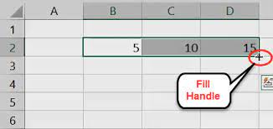
Relative and Absolute Cell References
Copy the formula from B2 into cell B3 using the fill handle (B3 shows $30 still because it is relative)

Slide 35
Relative and Absolute Cell References
In A3 type the value 500 to represent $500 sales
B3 updates to show 0.3*500 = $150 in costs
But now we always want to reference A2 no matter where we copy:
Enter formula =$A$2*0.3 in cell C2
Copy C2 down to C3
C3 holds formula =$A$2*0.3 referencing A2 absolutely

Slide 36
Sorting and Filtering Data
Sorting
Rearranges data based on selected column
Sort A to Z or smallest to largest
Steps:
Select data range
Go to Data tab > Sort
Choose sort column & order
Sort by additional columns as needed

Slide 37
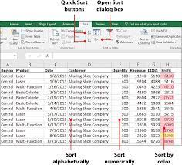
Sorting and Filtering Data
Sorting

Slide 38
Sorting and Filtering Data
Filtering
View subset of data meeting criteria
Rows hidden instead of rearranged
Steps:
Select data range
Click filter icon on column
Uncheck boxes to hide those values
Advanced filters for more logic

Slide 39
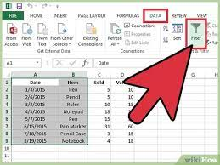
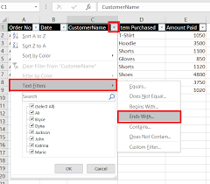
Sorting and Filtering Data
Filtering

Slide 40
Sorting and Filtering Data
Exercise
Prepare sample data
Enter Names in column A
Enter Test Scores in column B
Sort the Data
Click on any cell in the table
Go to Data > Sort
In Sort By, choose the Test Scores column
Sort Smallest to Largest
Click Add Level
Then sort by Names A to Z
This will sort all scores with the lowest grades first and alphabetize names with the same score.

Slide 41
Sorting and Filtering Data
Filter the Data
Click the filter icon at the top of the Test Score column
Uncheck boxes for 80 and 90
This will hide all rows with test scores of 80 or 90
Click OK to filter
You can now only view rows for grades 70 and below or grades higher than 90.
Clear Filters/Sorts
Choose Clear under Data tab to remove filters
This unhides any hidden rows
Sort icon undoes column sorting

Slide 42
Freezing Panes
Freezing panes locks certain rows or columns on a worksheet to remain visible while scrolling through other parts of the sheet.
This helps when analyzing data tables that span multiple rows and columns.
How to Freeze Panes:
Select the cell below the rows and to the right of columns you want frozen
Go to View tab > Freeze Panes > Freeze Top Row/Freeze First Column
You can also freeze both rows and columns in place by selecting a central cell and choosing Freeze Panes.
This will keep the frozen areas static, while allowing the cells below and to the right to scroll.

Slide 43
Freezing Panes
Use Cases:
Keep column headers in place when scrolling vertically through a data table
Keep row labels fixed when looking across many horizontal fields
Freeze a top left table/matrix while scrolling larger data regions
Best Practices:
Keep the frozen areas to a minimum size necessary
Put most variable data beneath and to the right
Avoid freezing a lot of empty cells
Unfreeze panes when no longer needed

Slide 44
Summary
Key Points
Excel helps organize, analyze and report on data to support smarter decisions through features like sort, filter, formulas with cell references.
Learning keyboard shortcuts and the order of operations in formulas saves time and helps avoid common errors. Freezing panes also enables easier data analysis.
A little bit of formatting setting borders, colors, text attributes goes a long way in improving interpretability and communication value. But don't let formatting distract from the accuracy of the analysis.
Whether you are a complete beginner or an experienced Excel power user, there is always more to learn. Using Excel daily, googling guides as needed, taking classes and increasing fluency will boost productivity.

Slide 45
SQL Exercise
Importing from SQL Database
In Excel Data tab, choose New Query> From Database > From SQL Server
Enter MSS-P1-BISS-01 in the server box
Enter AdventureWorks2012 in the database box
Click ok and use your credentials
Click Advanced Options
Enter SQL Statement:
SELECT Name, Color, Size, ListPrice
FROM Production.Product
WHERE ProductSubcategoryID IN (1, 2, 3)
Click Load

Slide 46
SQL Exercise
Analyze and Format the Table
Sort the table by Size ascending then by Name
Add a Total Price column with a SUM formula
Filter to only show sizes between 35 and 40
Freeze top row and first column

